Slide 1

THIRTEENTH 24 HEROES IN 24 HOURS – 22 MAY 2026
CrossFit Mainline – Wayne, Pennsylvania, USA
https://www.24heroes.com

Slide 2
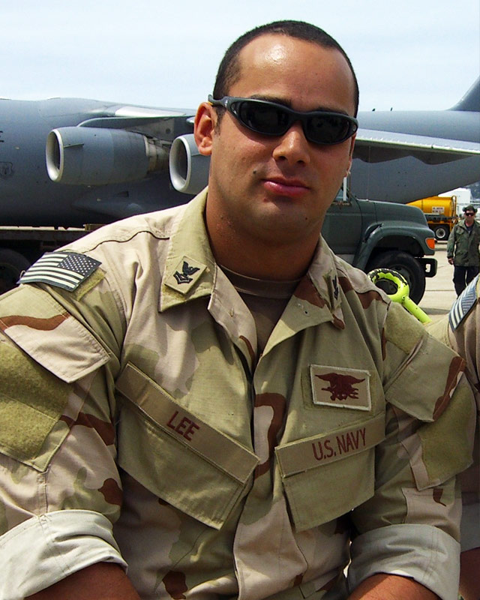
HERO WOD #1: Marc Alan Lee
Friday 0930
Background: This workout is dedicated to Marc Alan Lee who was the first SEAL to lose his life on August 2, 2006, in Operation Iraqi Freedom when he was killed in a fierce firefight while on patrol against insurgents in Ramadi.
A fellow SEAL Team 3 member, Ryan “Biggles” Job, was critically injured by a sniper and Lee single-handedly provided cover fire while other team members prepared Job for medical evacuation. The team re-engaged the enemy force after the evacuation of Job. Lee was mortally wounded when he exposed himself a third time to draw fire from enemy forces away from his teammates. For his action on the battlefield, Lee was posthumously awarded the Silver Star, the Bronze Star Medal with Valor and the Purple Heart.
Jocko Willink is a highly decorated retired U.S. Navy SEAL officer and commander of SEAL Team 3's Task Unit Bruiser. He is also the author of Extreme Ownership, a leadership philosophy built on a single, uncompromising principle: as a leader, you are entirely responsible for everything in your world — successes and failures alike. The loss of Marc, and others under his command, is something he takes deeply and personally to heart.
** Jocko contributed to this WOD’s format.
For Time: Buy-In: 251 meter Row
Then, 3 Rounds of:
8 Deadlifts (315/275 lb)
2 minute Plank Hold
6 Bar Over Burpees
48 Jumping Jacks
28 Push-Ups
©2026 – 24 Heroes in 24 Hours https://www.24heroes.com
Notes:
https://wodwell.com/wod/marc-alan-lee/
Of Marc himself, Willink speaks with unmistakable reverence. He describes him as a "mighty warrior" — yet equally as a compassionate and humorous soul who brought smiles, laughter, and love even in the darkest moments of war. In Willink's eyes, Marc was the embodiment of selfless courage: a man who gave his life defending his teammates in Ramadi.

Slide 3
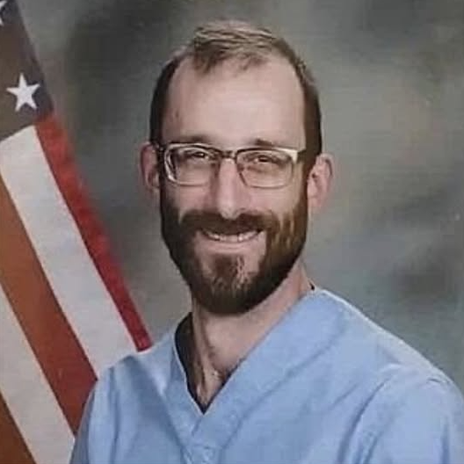

HERO WOD #2: Pretti Good
Friday 1030
WORKOUT:
37 MIN AMRAP, consisting of:
3 Devil Press
10 Wall Balls
47 dubs
Alex was an ICU nurse for our Veterans who dedicated his life to caring for others. He was a kind soul who was shot point-black while assisting a woman who had been shoved to the ground by federal ICE agents. Renee Good was a legal observer who was driving home after dropping her child off at school when she was killed.
Rene was killed by 3 point-blank gunshots.
Alex Pretti was killed by 10 gunshots to the BACK.
Rene Good and Alex Pretti were both 37 years old when they were slain by the Trump administration's ICE agents in Minneapolis.
The 47 "double unders" or "dubs" per round is relevant too: this number is for the 47th President of the United States, who is ultimately responsible for the "Operation Metro Surge" ICE raid in Minneapolis.
©2026 – 24 Heroes in 24 Hours https://www.24heroes.com
Notes:
This is modern-day domestic violence—not between partners, but wielded by the federal government through unlawful and unconstitutional force against its citizens.
Both Good and Pretti were 37 years old. Good, a mother of three, “suffered three clear gunshot wounds, including one to her head,” according to her family’s lawyers. Their findings were based on an autopsy commissioned by her family in the wake of unsubstantiated claims that she was attempting to run over an ICE agent.
Then, over the weekend, the world watched in horror as federal agents fatally shot Alex Pretti, an intensive care nurse at the Minneapolis Veterans Affairs medical center. By the accounts of patients, friends and family, he dedicated his life to caring for others. According to reporting from The New York Times, photos and videos taken from multiple angles, analyzed by news organizations and posted online, ICE agents “appear to fire at least 10 shots in a span of five seconds,” rattling Pretti’s body with bullets, including in the back. This all after being tackled by a group of ICE agents.

Slide 4
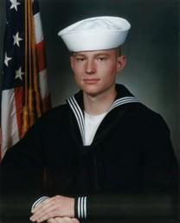
HERO WOD #3: FAAS Fit
Friday 1130
Background: The “Faas Fit” Hero WOD is dedicated to John Weston Faas, a US Navy Seal who died during a helicopter crash in Afghanistan on Saturday, August 6, 2011. John graduated from Minnehaha Academy in 1998 where he was co-valedictorian of his class. He was also captain and quarterback of the football team. John spent many years practicing the martial arts and had a Black Belt in Tae Kwan Do at 12 years of age.
We first found the “Faas Fit” Hero WOD posted by CrossFit New England as part of their “24 Heroes in 24 Hours” fundraiser (these days, they call it the “24-Hour SEAL Team Challenge”) in October 2017, honoring fallen US Navy Seals. They modified it as per our original suggestions to CFNE.
3 Rounds for Time (with a Partner)
10 Deadlifts (315/205 lb)
20 Pull-Ups
30 Kettlebell Snatches (53/35 lb)
©2026 – 24 Heroes in 24 Hours https://www.24heroes.com
Notes:
https://wodwell.com/wod/faas-fit/

Slide 5
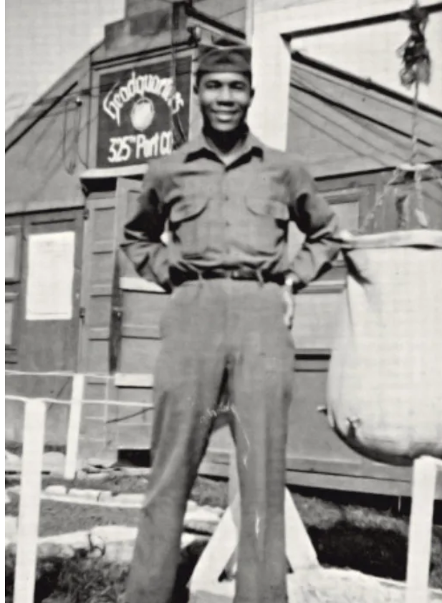
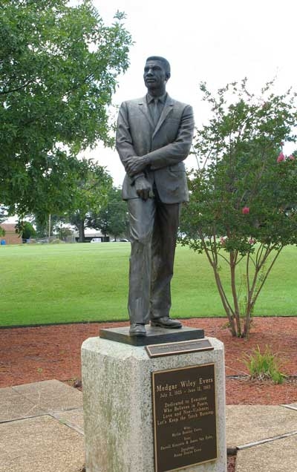
HERO WOD #4: Medgar (for Medgar Evers)
Friday 1230
Background: A WWII veteran who survived the beaches of Normandy only to return home to Mississippi to fight a different kind of fascism. As a leader of the NAACP, he fought for voting rights and desegregation before being assassinated by a white supremacist in 1963.
His impact to the voting rights movement is still felt today, from the university named in his honor i Upstate New York to the Medgar & Myrlie Evers Institute in Jackson, MS that continues his work and education.
6 Rounds for Time:
12 Pull-ups (Representing June 12th)
63 Kettlebell Swings 55/35# (Representing 1963)
37 Burpees (His age when he was killed)
Buy-in / Cash-Out: Start and/or end with a 1944m Row to honor his D-Day service.
©2026 – 24 Heroes in 24 Hours https://www.24heroes.com

Slide 6
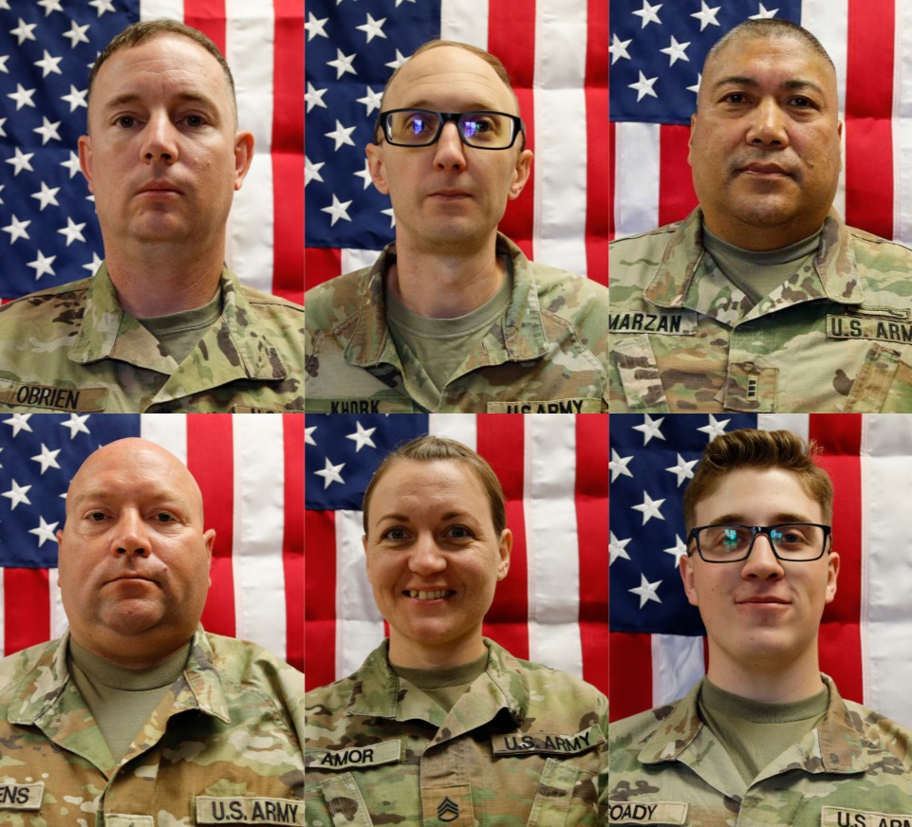
HERO WOD #5: The Kuwait Six
Friday 1330
Background: All six soldiers were assigned to 103rd Sustainment Command, Des Moines, Iowa. NOTE: This was the deadliest attack on U.S. troops since the Afghanistan withdrawal of 2021 — and injured more than 20 others.
Maj. Jeffrey O’Brien, 45, of Waukee, Iowa, Capt. Cody Khork, 35, of Winter Haven, FL., Sgt. 1st Class Nicole Amor, 39, of White Bear Lake, MN., Sgt. 1st Class Noah Tietjens, 42, of Bellevue, NE., and Sgt. Declan Coady, 20, of Des Moines, IA, were killed Sunday in the retaliatory Iranian strike on Port of Shuaiba, Kuwait. The Pentagon believes Chief Warrant Officer 3 Robert Marzan, 54, of Sacramento, CA, also died in the attack.
This location was a lightly protected, older-style base with no aerial defenses. The Unit was unprepared to provide any defense and had minimal protection from aerial threats, causing chaos, severe injuries, improvised medical care, and even civilian vehicles had to be used for evacuation.
“We honor our fallen Heroes, who served fearlessly and selflessly in defense of our nation. Their sacrifice, and the sacrifices of their families, will never be forgotten,” Lt. Gen. Robert Harter, commanding general of the Army Reserve Command, said in the Army Reserve release.
6 rounds for time of:
3x Chest-to-Bar Pullups
1x burpee over rower
26 Dubs
103 Meter row
©2026 – 24 Heroes in 24 Hours https://www.24heroes.com

Slide 7

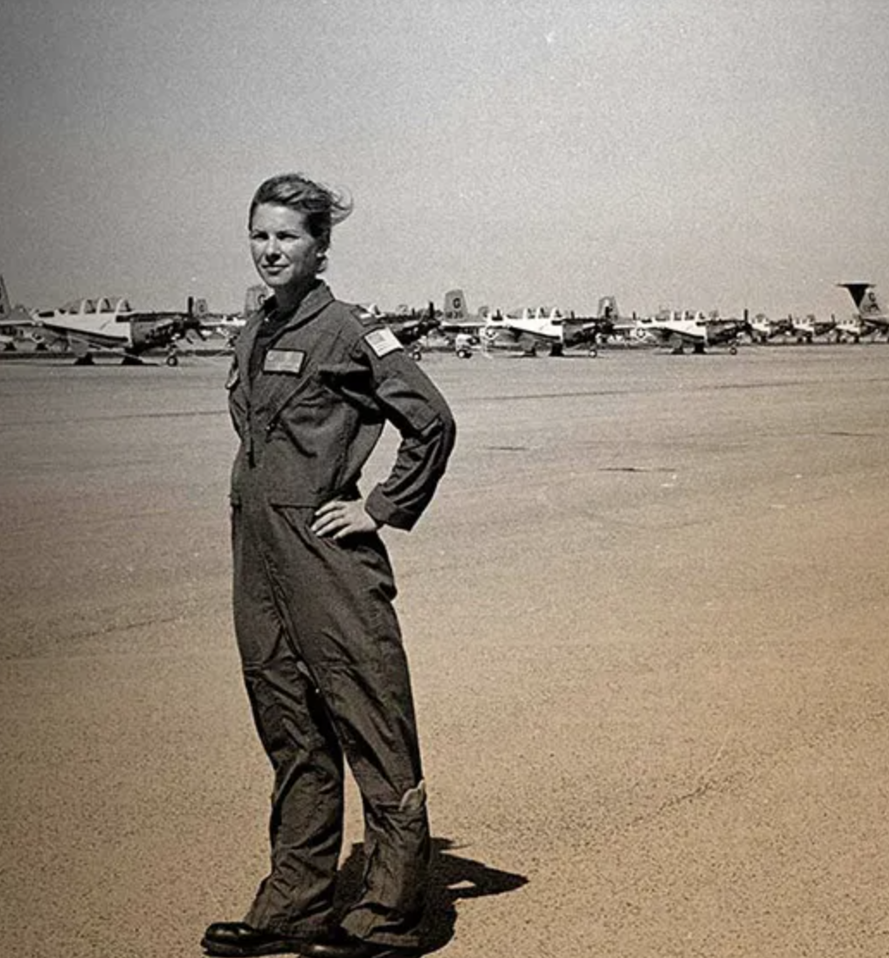
HERO WOD #6: Valerie
Friday 1430
Background: LT Valerie Cappelaere Delaney was a Naval Academy graduate (2009) and EA-6B Prowler pilot who lived by the motto "adapt and overcome". She passed away on March 11, 2013, in a jet training crash in Washington state, and is remembered for her leadership and spirit.
Military Career: A 2009 USNA graduate with an Aeronautical Engineering degree, she became a Naval Aviator, earning her Wings of Gold in February 2012.
Service: She served as an Electronic Attack Squadron 129 pilot at NAS Whidbey Island, WA.
Athletics: She was a member of the Navy Women's Lacrosse team during their transition to Division I, known for her dedication and passion for the game. Valerie wore the number "6" at the Academy - hence the 6 rounds.
6 rounds for time:
10 Deadlifts (95/65#),
10 Pull-ups,
10 Burpees,
10 Power Cleans (95/65#),
10 Kettlebell Swings (55/35#)
©2026 – 24 Heroes in 24 Hours https://www.24heroes.com

Slide 8
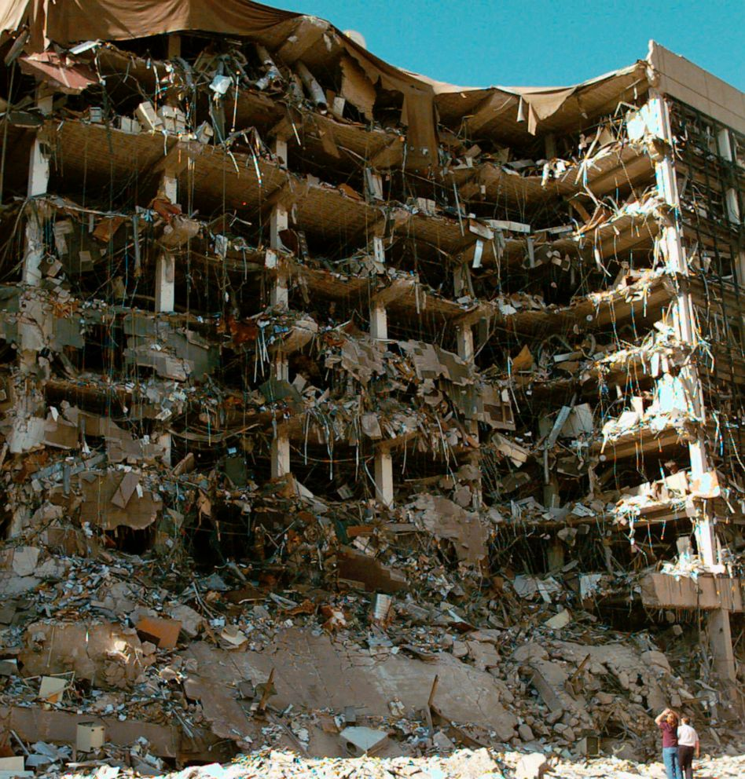
HERO WOD #7: The Oklahoma Standard
Friday 1530
Background: This tribute workout is dedicated to the victims of the Oklahoma City Bombing that happened on April 19, 1995.
The Oklahoma City bombing was a domestic terrorist truck bombing of the Alfred P. Murrah Federal Building in Oklahoma City, Oklahoma, United States. Perpetrated by American white supremacist terrorists, Timothy McVeigh and Terry Nichols, the bombing happened at 9:02 am and killed at least 168 people, including numerous women and children, injured more than 680 others, and destroyed more than one-third of the building, which had to be demolished.
4 Rounds for Time (with a Partner)
19 Synchro Lunges (45/25 lb)
19 Synchro Push-Ups
95 Wall Ball Shots (20/14 lb)
Buy-Out: 168 Burpee Box Jumps (24/20 in)
©2026 – 24 Heroes in 24 Hours https://www.24heroes.com

Slide 9
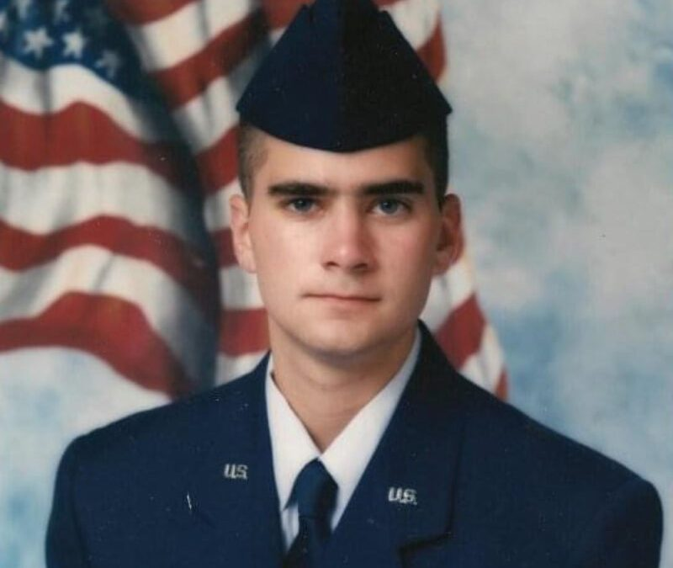
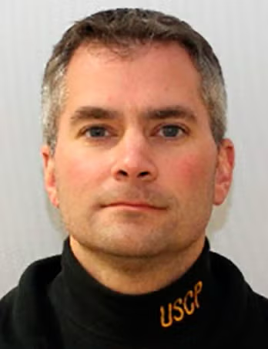
HERO WOD #8: SICKNICK
Friday 1630
Background: Capitol Police Officer Brian Sicknick was assaulted by insurrectionists seeking to overthrow the US government during the Capitol attack on January 6, 2021. He succumbed to his injuries and died the next day in the hospital. He joined the Capitol Police in 2008.
Officer Sicknick is from South River, NJ. A 1997 graduate of Middlesex County Vocational and Technical School, Sicknick "wanted to be a police officer his entire life," according to his family. He joined the New Jersey Air National Guard the year he graduated. Sicknick deployed to Saudi Arabia in 1999 in support of Operation Southern Watch. After the 9/11 terrorist attacks, he served in Kyrgyzstan in support of the war in Afghanistan.
As with most Hero WODs, the numbers have meaning. The date, 13 years of services to the Capitol Police, and 45 for the “dumbbell” who caused it.
13 Rounds for Time, of:
- 1 Devils Press (45# DB)
- 6 DB Thrusters (45# DB)
- 21 Double-unders
©2026 – 24 Heroes in 24 Hours https://www.24heroes.com

Slide 10

HERO WOD #9: Randy
Friday 1730
Background: Randy Simmons was a Los Angeles Police Department SWAT Officer who was tragically killed in the line of duty on February 7, 2008. He had one of the largest funerals in Los Angeles history because of his love and dedication to The City of Los Angeles. Randy Simmons was not just an elite police officer, he was also a community leader and mentor to hundreds of at-risk city kids that he recruited, mentored and helped to navigate through the often difficult and dangerous circumstances of their neighborhoods.
For Time
75 Power Snatches (75/55 lb)
http://www.randalsimmons.org/
©2026 – 24 Heroes in 24 Hours https://www.24heroes.com

Slide 11
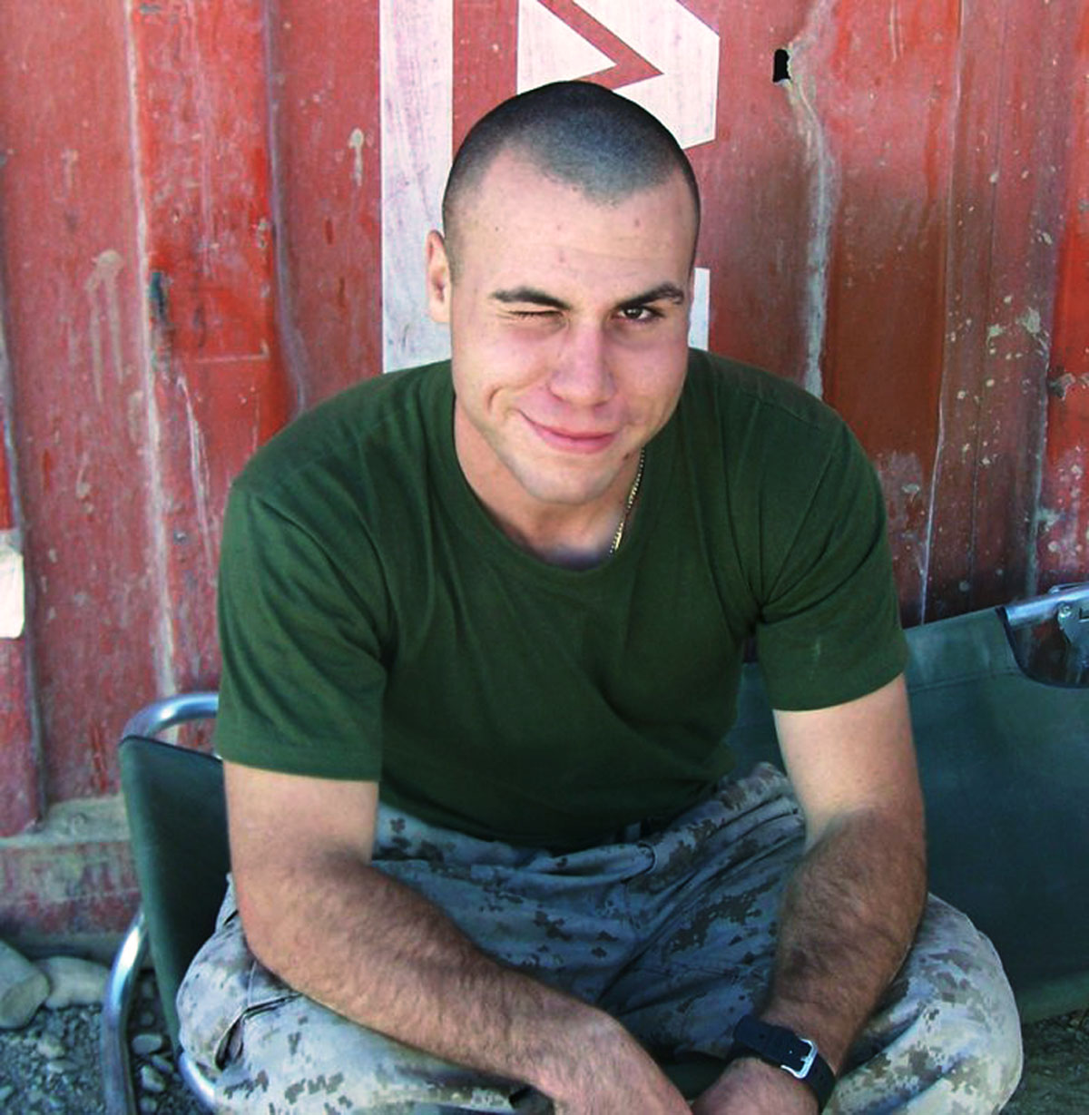
HERO WOD #10: J.J.
Friday 1830
Background: U.S. Marine Lance Corporal Justin James “JJ” Wilson, 24, of Palm City, FL, assigned to 3rd Battalion, 10th Marine Regiment, 2nd Marine Division, II Marine Expeditionary Force, based in Camp Lejeune, NC, was killed on March 22, 2010, while supporting combat operations in Helmand province, Afghanistan.
He is survived by his wife Hannah McVeigh, parents Lance and Frances, brother Christopher, and sister Jamie-Ella.
Ascending/Descending workout For Time
1-10 Full Barbell Clean (185/135#)
10-1 Parallette Handstand Push-Ups
(1 clean, 10 HSPU, 2 cleans, 9 HSPU, 3 cleans, 8 HSPU, cont’d)
©2026 – 24 Heroes in 24 Hours https://www.24heroes.com

Slide 12
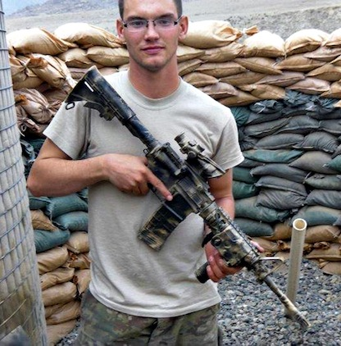
HERO WOD #11: Donny
Friday 1930
Background: U.S. Army Specialist Donald L. Nichols, 21, of Shell Rock, IA, assigned to the 1st Battalion, 133rd Infantry Regiment, Iowa Army National Guard, based in Waterloo, IA, died April 13, 2011, in Laghman province, Afghanistan, of wounds suffered when insurgents attacked his unit using an improvised explosive device.
He is survived by his mother and stepfather, Roger and Becky Poock; his father and stepmother, Jeff and Jeanie Nichols; and his brothers, Nick and Joe.
21-15-9-9-15-21 Reps, For Time
Deadlifts (225/155 lb)
Burpees
©2026 – 24 Heroes in 24 Hours https://www.24heroes.com

Slide 13
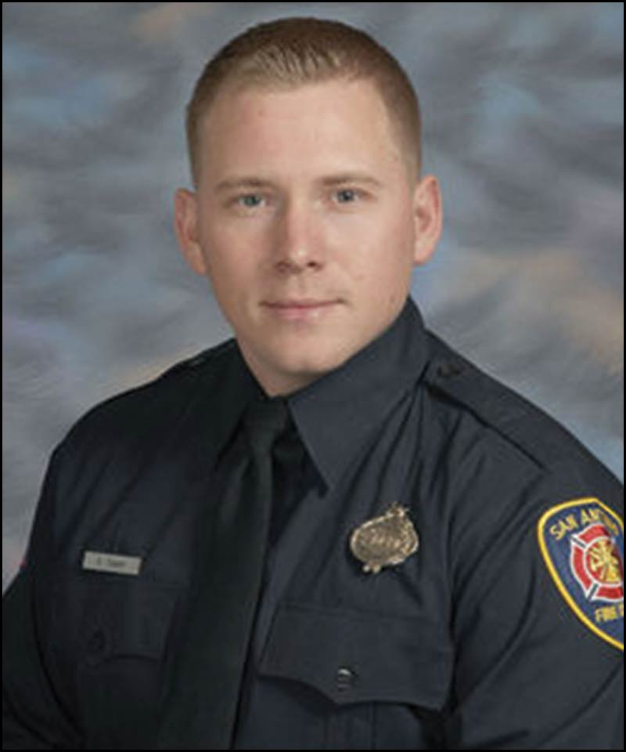
HERO WOD #12: Scotty
Friday 2030
Background: Scott “Scotty” Deem, 31, of San Antonio, Texas, was killed while responding to a four-alarm structure fire on May 18, 2017. Deem and his fellow firefighters were searching the building for survivors, but after 11 minutes, Deem sounded a Mayday call. Rescuers were unable to locate him in time.
Deem served with the San Antonio Fire Department for six years. The department is home to a non-profit CrossFit affiliate, where he worked hard to stay in peak physical health. His favorite workouts included “The Chief,” “DT” and “Lynne.”
AMRAP in 11 minutes
5 Deadlifts (315/205 lb)
18 Wall Ball Shots (20/14 lb)
17 Bar Over Burpees
©2026 – 24 Heroes in 24 Hours https://www.24heroes.com

Slide 14
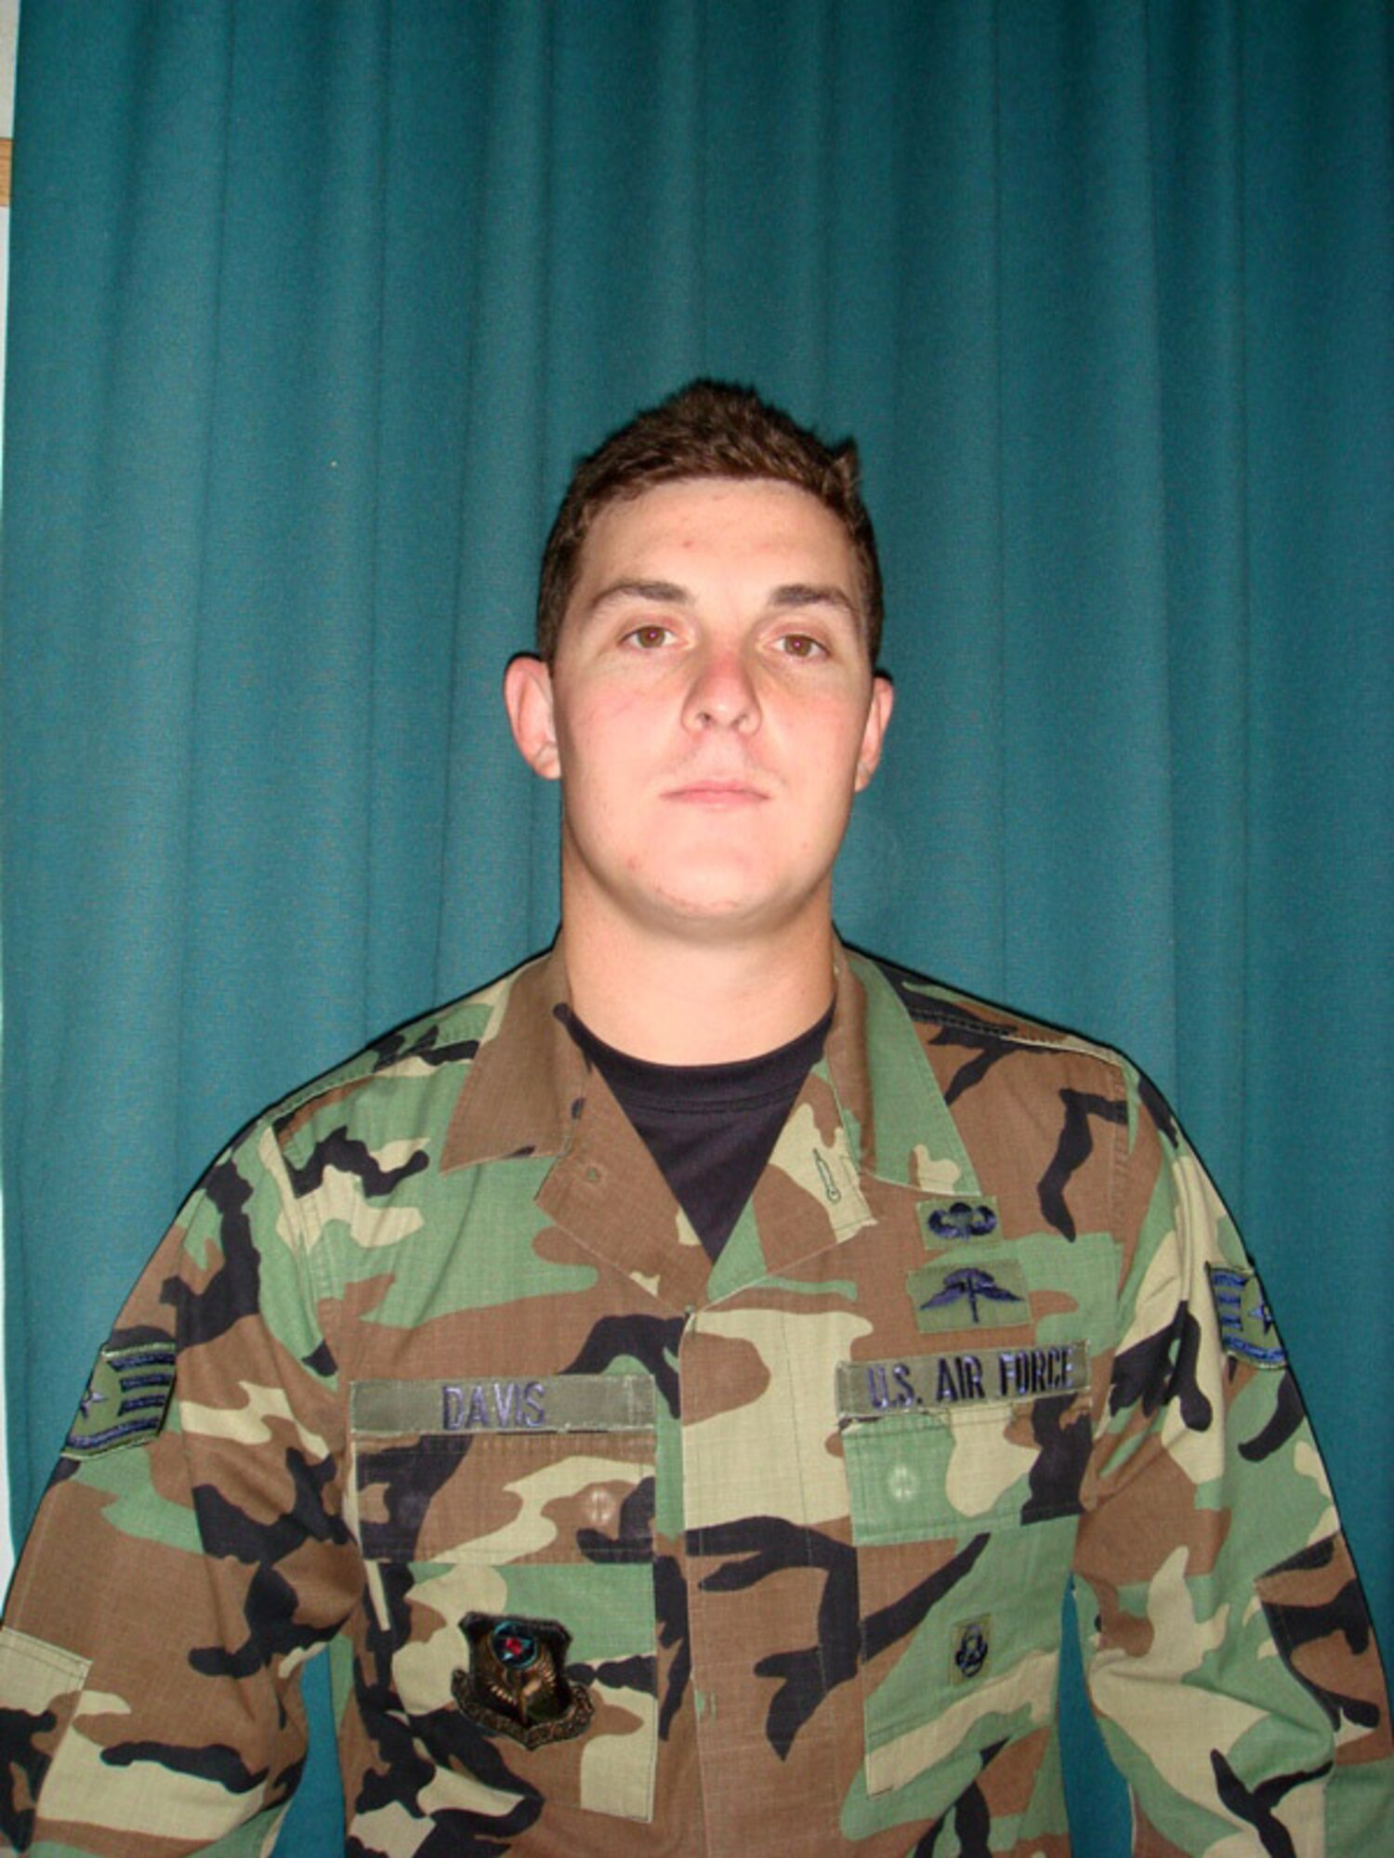
HERO WOD #13: DT
Friday 2130
Background: In honor of US Air Force SSgt Timothy P. Davis, 28, who was killed on Feburary, 20 2009 supporting operations in OEF when his vehicle was struck by an IED. Timothy was survived by his wife Megan and his son, T.J., who was one year old when he passed.
The original “DT” Hero WOD was first posted on the CrossFit main site as the workout of the day for Tuesday, April 14, 2009 (“090414“).
5 Rounds For Time
12 Deadlifts (155/105 lb)
9 Hang Power Cleans (155/105 lb)
6 Push Jerks (155/105 lb)
©2026 – 24 Heroes in 24 Hours https://www.24heroes.com

Slide 15
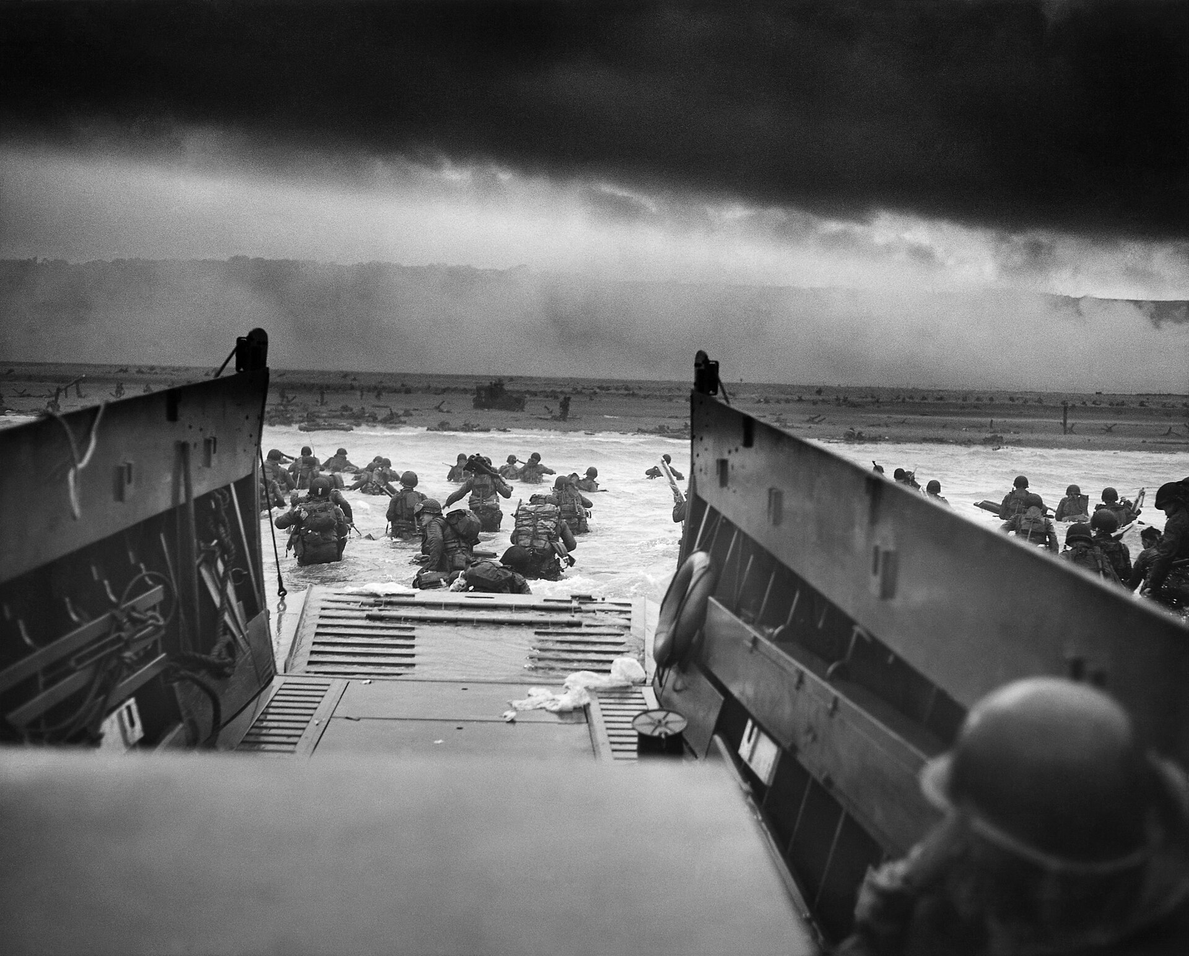
HERO WOD #14: D-Day Remembrance WOD
Friday 2230
Background: This tribute WOD is in memory of the anti-fascist soldiers who lost their lives in the Normandy landings (the landing operations on Tuesday, 6 June 1944 – termed D-Day) of the Allied invasion of Normandy in Operation Overlord during World War II.
The largest seaborne invasion in history, the operation began the liberation of German-occupied northwestern Europe from Nazi control, and contributed to the Allied victory on the Western Front. Operation Overlord ended on August 25, 1944, when Paris was liberated.
The operation started with air landings and a massive amphibious attack in the early morning of June 6th. After the landing, the first attempt was made to maintain and expand the Normandy bridgehead. Various operations were undertaken for this, and during Operation Cobra the Allies finally broke through the German lines. When the Germans collapsed with Falaise, the battle in Allied was definitely a benefit. The road to Paris was opened and the French capital on the Seine was taken.
For Time :
1944 meter Row
Then, 6 Rounds of:
30 Burpees
30 Sit-Ups
30 Double-Unders
30 Walking Lunges
©2026 – 24 Heroes in 24 Hours https://www.24heroes.com

Slide 16
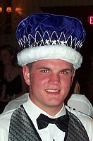
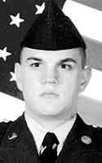
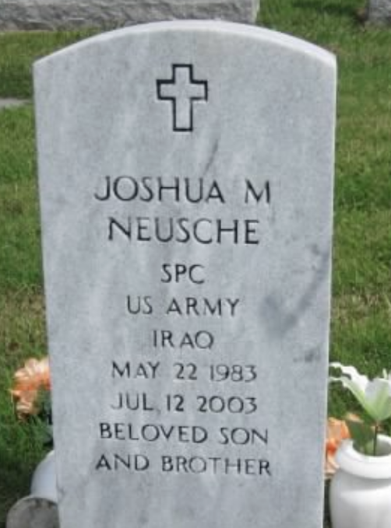
HERO WOD #15: Neusche
Friday 2330
Background: This workout is dedicated to U.S. Army Specialist Joshua Neusche, of Montreal, Missouri. SPC Neusche died from a non-combat cause in Homburg Hospital, Germany. Joshua was assigned to the 203d Engineer Battalion, in Joplin, Missouri, and died on July 12, 2003. The 203d was operating out of the Baghdad International Airport (BIAP) in a small forward operating base established after the “Battle of Baghdad” in April 2003.
He would have died alone in that German hospital if it weren’t for the soldiers in his unit – over 650 soldiers each donated $10 to help pay for his family’s airfare from SW Missouri to Germany before he passed away.
3 Rounds For Time, of:
7 Power Snatch (95/65#)
12 burpees over bar
203 meter row
(WOD Significance: He passed away on July 12th, 2003, and was a member of the 203d Engineer Battalion.)
©2026 – 24 Heroes in 24 Hours https://www.24heroes.com

Slide 17
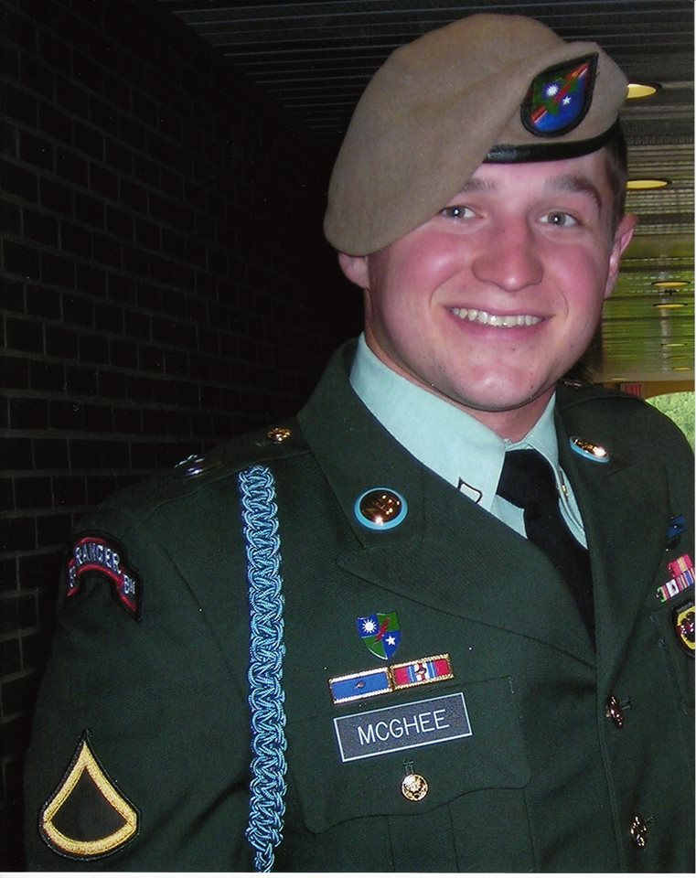
HERO WOD #16: McGhee
Saturday 0030
Background:
US Army Ranger, Corporal Ryan C. McGhee, 21, was an automatic rifleman assigned to 3rd Battalion, 75th Ranger Regiment at Fort Benning, Ga. He was born on Nov. 4, 1987 in Pennsylvania.
He was killed by small arms fire while conducting combat operations in Central Iraq, when his unit came in contact with enemy forces. The unit was conducting operations to rid Iraq of a weapons facilitator and suicide vest cell known to be operating in the area. McGhee was on his fourth deployment in support of the War on Terror with three previous deployments to Afghanistan.
AMRAP in 30 minutes
5 Deadlifts (275/185 lb)
13 Push-Ups
9 Box Jumps (24/20 in)
©2026 – 24 Heroes in 24 Hours https://www.24heroes.com

Slide 18
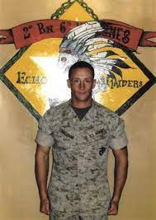
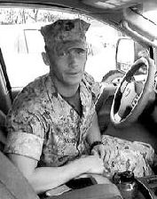
HERO WOD #17: Zimmerman
Saturday 0130
Background: U.S. Marine Corps First Lieutenant James R. Zimmerman, 25, of Aroostook, ME, assigned to 2nd Battalion, 6th Marine Regiment, 2nd Marine Division, II Marine Expeditionary Force, based in Camp Lejeune, NC, died on November 2, 2010, while conducting combat operations in Helmand province, Afghanistan.
He is survived by his wife Lynel Winters, parents Tom and Jane, sister Megan, and brother Christian.
AMRAP in 25 minutes
11 Chest-to-Bar Pull-Ups
2 Deadlifts (315/205 lb)
10 Handstand Push-Ups
©2026 – 24 Heroes in 24 Hours https://www.24heroes.com

Slide 19
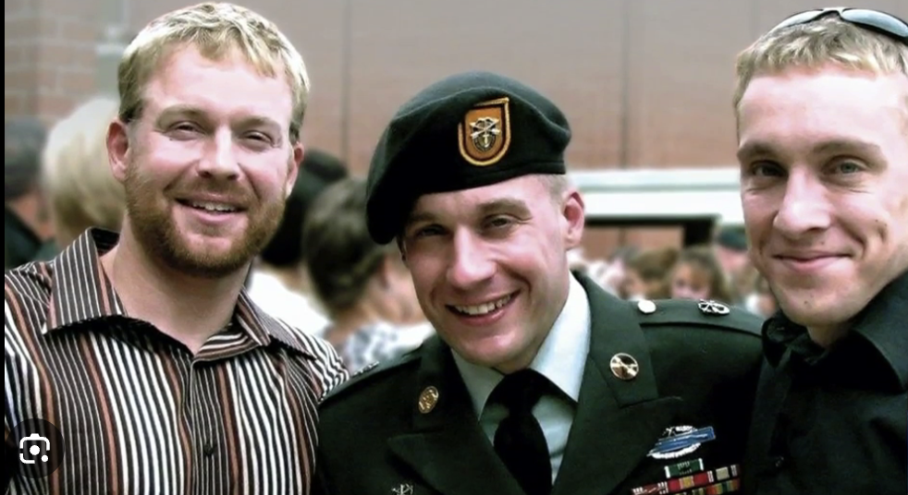
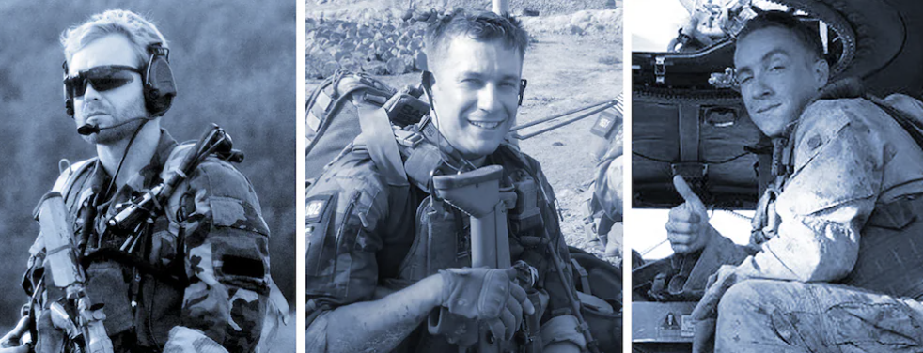
HERO WOD #18: Three Wise Men
Saturday 0230
Background: After the September 11th attacks on the US, Jeremy Wise joined the Navy and became a SEAL. Ben Wise, already in the Army, became a member of the legendary Green Berets. Beau Wise followed his brothers and joined the Marine Corps Infantry.
Together they served over 1,600 days in Iraq and Afghanistan. Tragically Jeremy was killed by a suicide bomber in Afghanistan on December 30, 2009. Just over two years later, Ben was killed in a firefight in Afghanistan on January 10, 2012. Beau remained on active duty in the United States Marine Corps. Following the deaths of his two brothers in Afghanistan, the military pulled Beau from the battlefield, making him the war's only known sole surviving member of his family.
Three AMRAPs in 16 minutes:
AMRAP in 4 minutes
5 Hang Squat Snatches (135/95 lb)
10 Bar-Facing Burpees
Rest 2 minutes, then:
AMRAP in 4 minutes
10 Power Cleans (135/95 lb)
20 Pull-Ups
Rest 2 minutes, then:
AMRAP in 4 minutes
15 Box Jump-Overs (24/20 in)
30 Wall Ball Shots (20/14 lb)
©2026 – 24 Heroes in 24 Hours https://www.24heroes.com

Slide 20
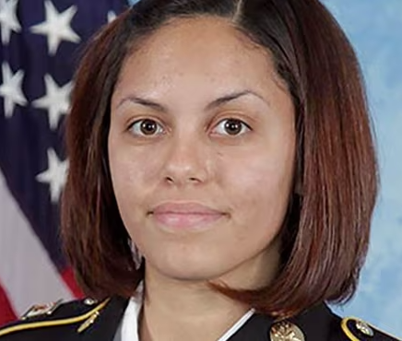
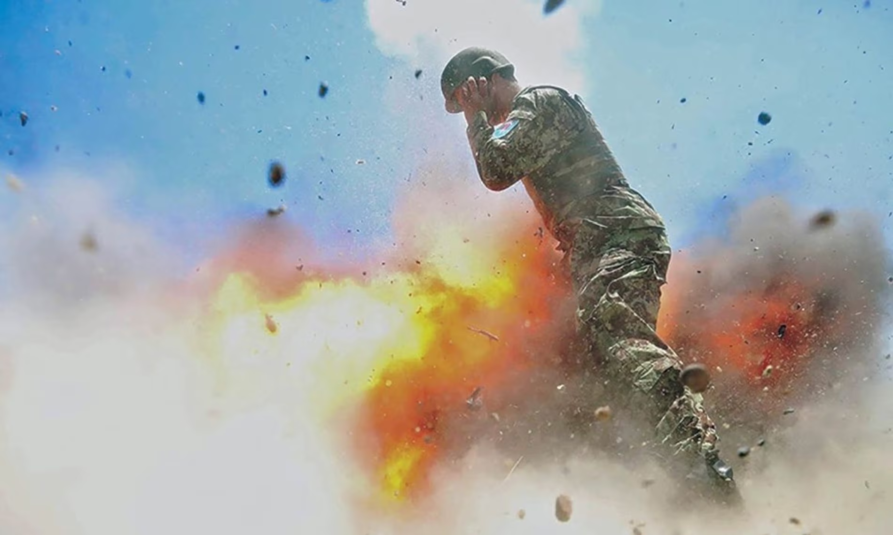
HERO WOD #19: HILDY
Saturday 0330
Background:
US Army Spc. Hilda Clayton, 22, of Augusta, Georgia, died on July 2, 2013 from injuries sustained when a mortar malfunctioned during an Afghan National Army training exercise in Qaraghahi, Afghanistan. Clayton was providing Combat Camera support at the time of her death.
In Hilda's honor, the 55th Signal Company (Combat Camera) created an annual event - The Specialist Hilda I. Clayton Best Combat Camera (COMCAM) Competition is designed to challenge combat camera personnel of all military branches to test the technical and tactical proficiencies of Department of Defense combat photographers.
For Time (with 20/14# weight vest)
100 calorie row
75 thrusters (45/35#)
50 pull-ups
75 wallballs (20/14#)
100 calorie row
©2026 – 24 Heroes in 24 Hours https://www.24heroes.com

Slide 21
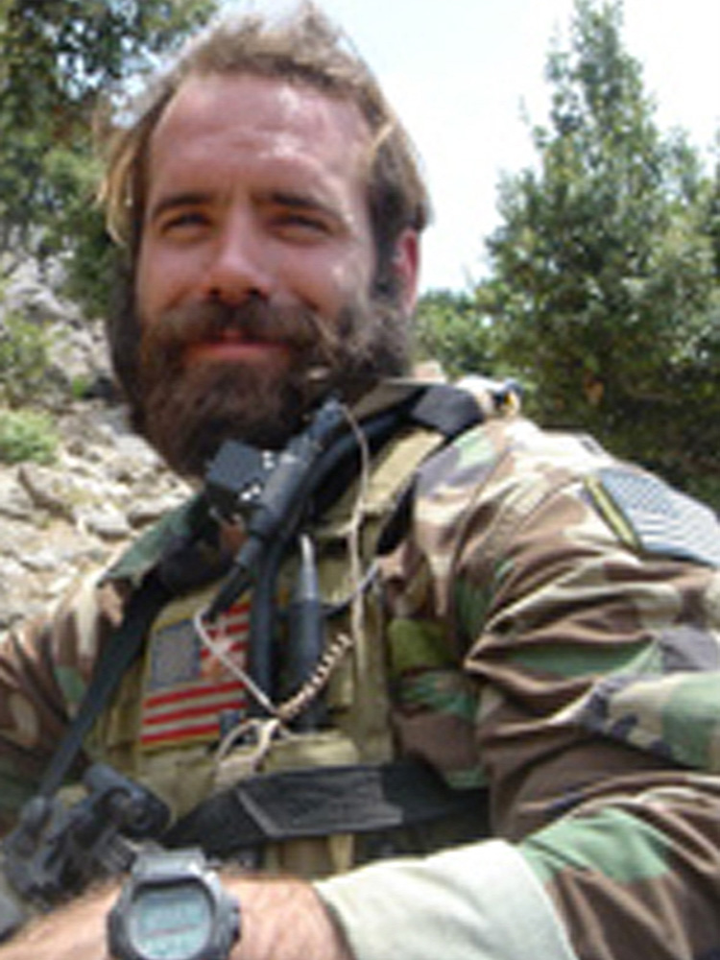
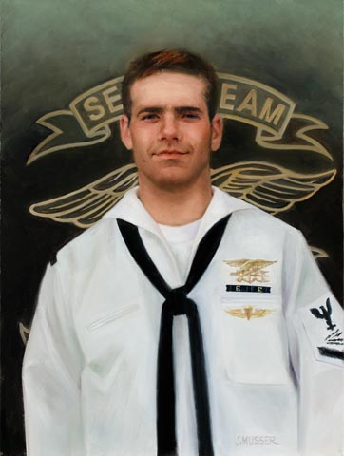
HERO WOD #20: Honey Badger
Saturday 0430
Background: This workout is dedicated to Navy Chief Petty Officer Mark Carter, Age 27, of Virginia Beach, VA who was killed in Irag 11 December 2007.
Mark knew exactly what he wanted to do when he joined the Navy after graduating from Fallbrook High School in 1998. He wanted to be a Navy SEAL.
He graduated from boot camp at Great Lakes, Ill., and then BUDS/SEAL training in Coronado, Calif. More than half of SEAL students drop out, but not Carter, a stocky 5-foot-5 and outdoor athlete who loved physical challenges.
He got the nickname “Honey Badger” from his fellow SEALs after beating a 6-foot-5 opponent in a wrestling match.
AMRAP (in a team of 3) in 30 minutes
30 FULL Cleans (95/75 lb)
30 Pull-Ups
800 meter Run (together)
©2026 – 24 Heroes in 24 Hours https://www.24heroes.com
Notes:
https://wodwell.com/wod/smette/
For Time (with a Partner)
4,000/3,000 meter Row
While Partner A Rows, Partner B completes AMRAP of:
5 Toes-to-Bars
10 Wall Ball Shots (20/14 lb)
15 Push-Ups
Partners switch as necessary
With a running clock, complete the 4,000/3,000 meter Row as fast as possible (“For Time“). While Partner A Rows, Partner B completes as many rounds and repetitions as possible (“AMRAP“) of 5 Toes-to-Bars, 10 Wall Ball Shots, and 15 Push-Ups. Switch as necessary and pick up where the other partner left off.
If one partner is male and the other is female, use 3,500 meters for the Row distance.
Score is the time on the clock when the Row is completed and the total number of rounds and repetitions completed of the AMRAP portion of the workout.

Slide 22
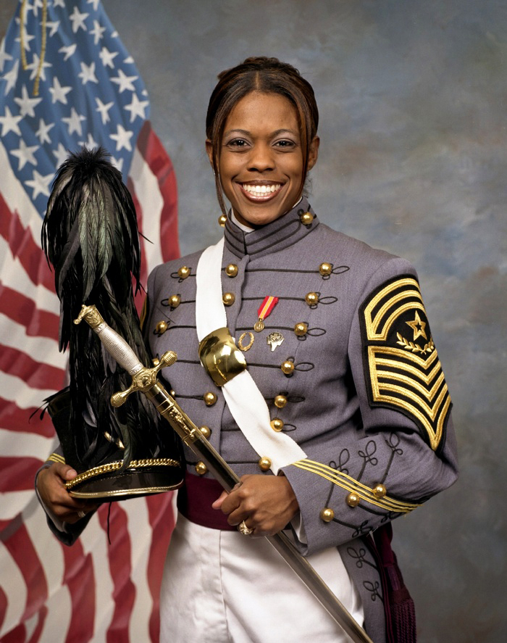
HERO WOD #21: Emily
Saturday 0530
Background: 2nd Lt. Emily Jazmin Tatum Perez, 23, was killed Sept. 12, 2006, when her Humvee was struck by an IED as she was leading a convoy through Al Kifl, Iraq. She served in the 204th Support Battalion, 2nd Brigade, 4th Infantry Division of the U.S. Army.
Perez earned numerous awards for her military service, including the Bronze Star, Purple Heart, Army Commendation Medal, National Defense Service Medal, Iraq Campaign Medal, Global War on Terrorism Service Medal, Army Service Ribbon, Overseas Service Ribbon, and the Combat Action Badge. She was also posthumously awarded the NCAA Award of Valor in 2008.
Perez was the first female African-American officer in U.S. military history to die in combat and the first female West Point graduate to die in the Iraq War. She is survived by her parents, Daniel and Vicki; brother, Kevyn; and many classmates and friends.
10 Rounds for Time, of:
30 Double-Unders
15 Pull-Ups
30 Air Squats
100 meter Sprint
2 minute Rest
©2026 – 24 Heroes in 24 Hours https://www.24heroes.com

Slide 23
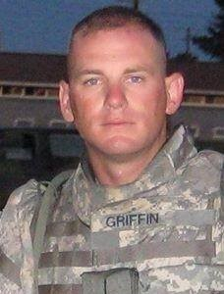
HERO WOD #22: Griff
Saturday 0630
Background: In honor of USAF SSgt Travis L. Griffin, 28, who was killed April 3, 2008 in the Rasheed district of Baghdad by an IED strike to his vehicle.
Staff Sgt. Travis Griffin knew the dangers of serving in Iraq, but the 28-year-old volunteered anyway as part of a yearlong deployment to help train Iraqi police officers. Griffin was on patrol in central Baghdad when his vehicle encountered a roadside bomb and he was killed, officials at Kirtland Air Force Base confirmed late Friday.
Griffin, who had served in the Air Force for nearly nine years, was a member of the 377th Security Forces Squadron at Kirtland. He had been stationed at the Albuquerque base since July 2004.
Travis is survived by his son Elijah.
For Time
800 meter Run
400 meter Run (backwards)
800 meter Run
400 meter Run (backwards)
©2026 – 24 Heroes in 24 Hours https://www.24heroes.com

Slide 24
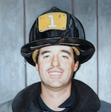
HERO WOD #23: Peter Carroll
Saturday 0730
This Firefighter Hero WOD is dedicated to Peter Carroll, FDNY, Squad 1, who was killed on September 11, 2001. They called him Pete the Painter. Pete Carroll was really a firefighter, but he painted apartments to make ends meet. He walked into ToniAnn’s life eight years ago and laid two coats of beige paint.
Mr. Carroll, 42, lost his life while evacuating streams of people from one of the World Trade Towers after Tuesday’s attack. He would lead workers from the building to the street, and then go back and repeat the process. Firefighters he worked with said there’s no telling how many lives he saved before the collapse. His body was found Wednesday at the site.
AMRAP in 8 minutes
5 Snatches (115/85 lb)
10 Burpees
©2026 – 24 Heroes in 24 Hours https://www.24heroes.com

Slide 25
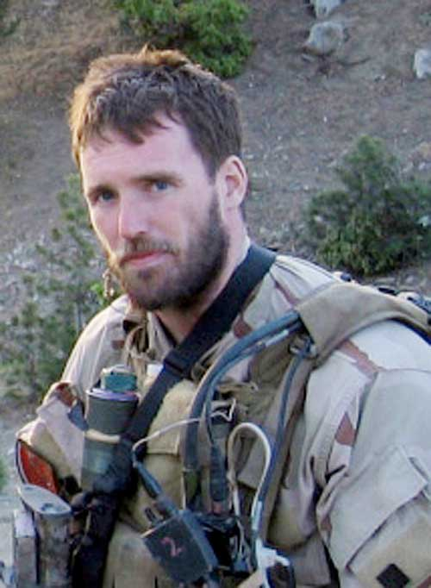
HERO WOD #24: MURPH
Saturday 0830
Background: In memory of Navy Lieutenant Michael P. Murphy, 29, of Patchogue, NY, who was killed in Afghanistan June 28, 2005. A U.S. Navy SEAL officer, Murphy was awarded the U.S. military’s highest decoration, the Medal of Honor, for his actions during the War in Afghanistan. His other posthumous awards include the Silver Star Medal (which was later upgraded to the Medal of Honor) and the Purple Heart.
The “Murph” Hero WOD was originally posted on the CrossFit Main Site as theWOD for August 18, 2005, where the post said “This workout was one of Mike’s favorites and he’d named it ‘Body Armor.’ From here on it will be referred to as ‘Murph’ in honor of the focused warrior and great American who wanted nothing more in life than to serve this great country and the beautiful people who make it what it is.” “Murph” has become one of the most famous CrossFit workouts, globally, especially as a tribute on U.S. Memorial Day as ““Memorial Day Murph.”
For Time (with 20/14# vest)
1 mile Run
100 Pull-Ups
200 Push-Ups
300 Air Squats
1 mile Run
©2026 – 24 Heroes in 24 Hours https://www.24heroes.com

Slide 27
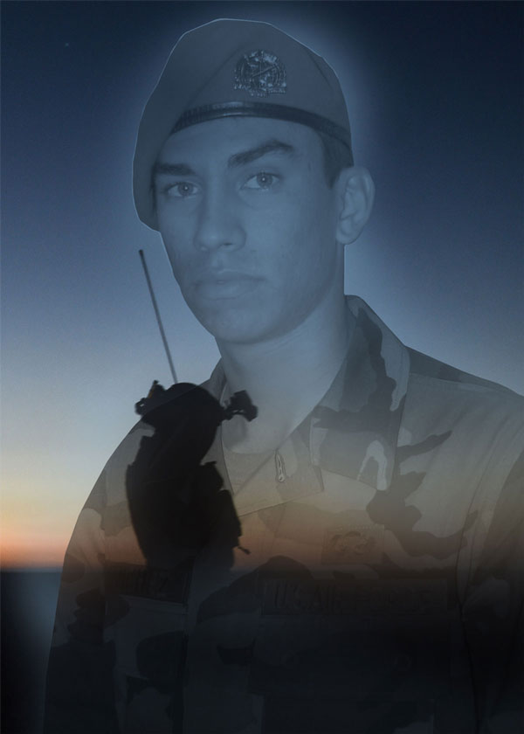
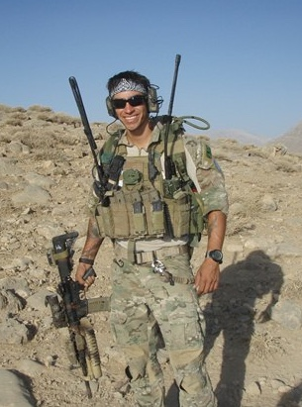
HERO WOD #20: Cheesy Jag
Saturday 0430
Background: The Cheesy Jag Hero WOD is a tribute designed to honor the memory of Sr Airman Daniel Ray Sanchez, an extraordinary individual known for his athleticism, resilience, and infectious spirit.
Daniel was killed in action in Afghanistan on September 16, 2020 during operation “enduring freedom.” A special forces combat controller and was on a mission in the Kajran District, Daniel and his team came under fire from an insurgent that was in the Afghan National Army Partner Force.
Daniel, admired for his prowess in running, cardio, and bodyweight movements, left a lasting impact on those who knew himThe Cheesy Jag Hero WOD represents his athletic prowess and the attributes that made him truly exceptional.
The workout itself consists of a 1-mile run and 5 rounds of 9 burpees, 16 air squats, and 10 push-ups. The rep scheme holds special significance as it symbolizes the date of Daniel’s passing. Each round completed pays tribute to his memory and embodies his call sign, “Jag 05.”
AMRAP in 23 minutes:
1 mile Run
Then, 5 cycles of:
9 Burpees
16 Air Squats
10 Push-Ups
Wear a Weight Vest (20/14 lb)
©2026 – 24 Heroes in 24 Hours https://www.24heroes.com
Notes:
https://wodwell.com/wod/wilmot/

Slide 28
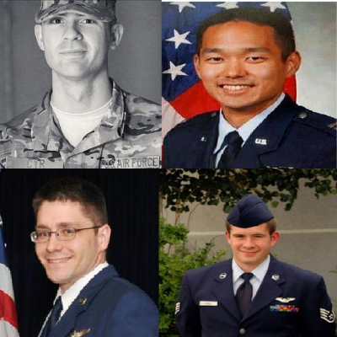
HERO WOD #21: INDY 08
Saturday 0530
Background: This workout is dedicated to the four crew members on board the MC-12W, tail number 09-0676 aircraft that crashed while on a combat intelligence, surveillance, and reconnaissance (ISR) mission on April 27, 2013.
The crew and MA were deployed to the 361st Expeditionary Reconnaissance Squadron, 451st Air Expeditionary Wing, KAF, Afghanistan. The MA, callsign Independence 08, departed KAF at 1157L and entered orbit at 1229L. The MA encountered deteriorating weather in the orbit and was climbing from 20,000 to 23,000 feet mean sea level (MSL) at 1241L to fly above the weather when the mishap occurred
Killed during the mission were Captains Capt. Brandon L. Cyr, of Woodbridge, Va. and Reid K. Nishizuka, of Lailua, Hawaii; Staff Sgt. Richard A. Dickson, of Rancho Cordova, Calif.; and Staff Sgt. Daniel N. Fannin, of Morehead, Ky.
Buy-In: 2,013 meter Air Bike, then:
AMRAP in 30 minutes
4 Toes-to-Bars
4 Burpees
27 Wall Ball Shots (20/14 lb)
©2026 – 24 Heroes in 24 Hours https://www.24heroes.com

Slide 29
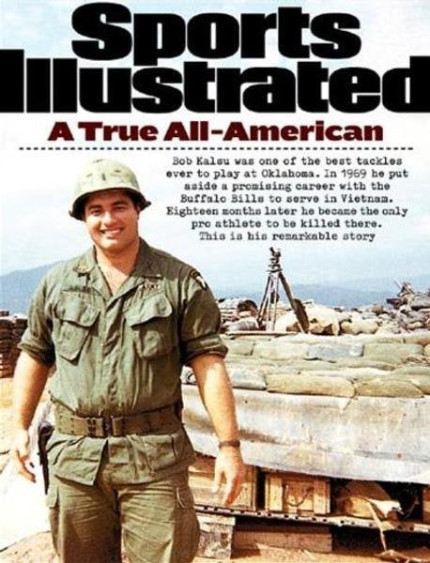
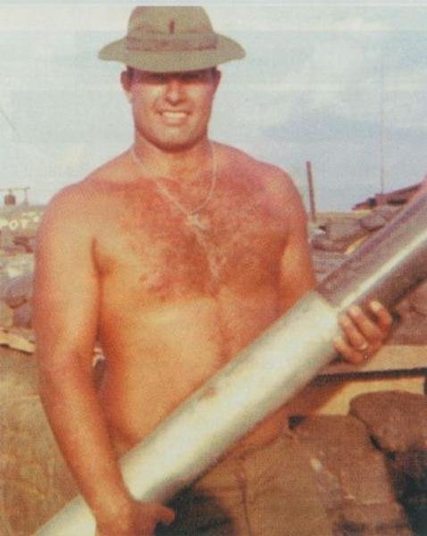
HERO WOD #16: KALSU
Saturday 0030
Background: The “Kalsu” Hero WOD honors 1st Lt. James Robert Kalsu, 11th Artillery Regiment, 101st Airborne Division, U.S. Army, who was killed in action on July 21, 1970 in the A Shau Valley, Vietnam. On lists of the hardest CrossFit workouts, “Kalsu,” is a frequent contender.
1st Lt. Kalsu was an All-American Offensive Tackle who played a single season with the Buffalo Bills (US National Football League) before leaving professional football to serve in Vietnam. 1st Lt. Kalsu was offered a deferment as a professional football player, but opted to honor his commitment to serve in the military.
For Time:
100 Thrusters (135/95 lb)
5 Burpees to start and at the top of every minute
Note: Partner up or suffer all day & night!
©2026 – 24 Heroes in 24 Hours https://www.24heroes.com
Notes:
1st Lt. James Robert Kalsu - https://wodwell.com/wod/kalsu/

Slide 30
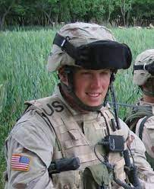
HERO WOD #1: Lt Hines
Friday 0930
Background: This workout is dedicated to 1LT Derek Hines, who was killed in action on September 1, 2005 in Baylough, Afghanistan, when elements of Battle Company, 1st Platoon and Headquarters Platoon came under attack from enemy small arms fire while searching for the leader of a Taliban IED cell. 1LT Hines continued to return fire against the attacking enemy forces despite his fatal wounds.
Born on July 9, 1980, 1LT Hines is remembered by his Paratroopers as an exceptional leader with a work ethic and competitiveness that went unmatched. His competitive nature translated into a truly relentless motivation to take the fight to the enemy that would consistently distinguish him under fire throughout Battle Company’s deployment.
For Total Reps (with a Partner)
Buy-In with a Buddy:
50 Push-Ups
50 Sit-Ups
50 Air Squats
Then, EMOM for 25 minutes of:
100 meter Shuttle Run (50 meters to touch the Rock then 50 meters back)
Plank Hold (alternating)
©2026 – 24 Heroes in 24 Hours https://www.24heroes.com
Notes:
https://wodwell.com/wod/1lt-derek-hines/

Slide 31
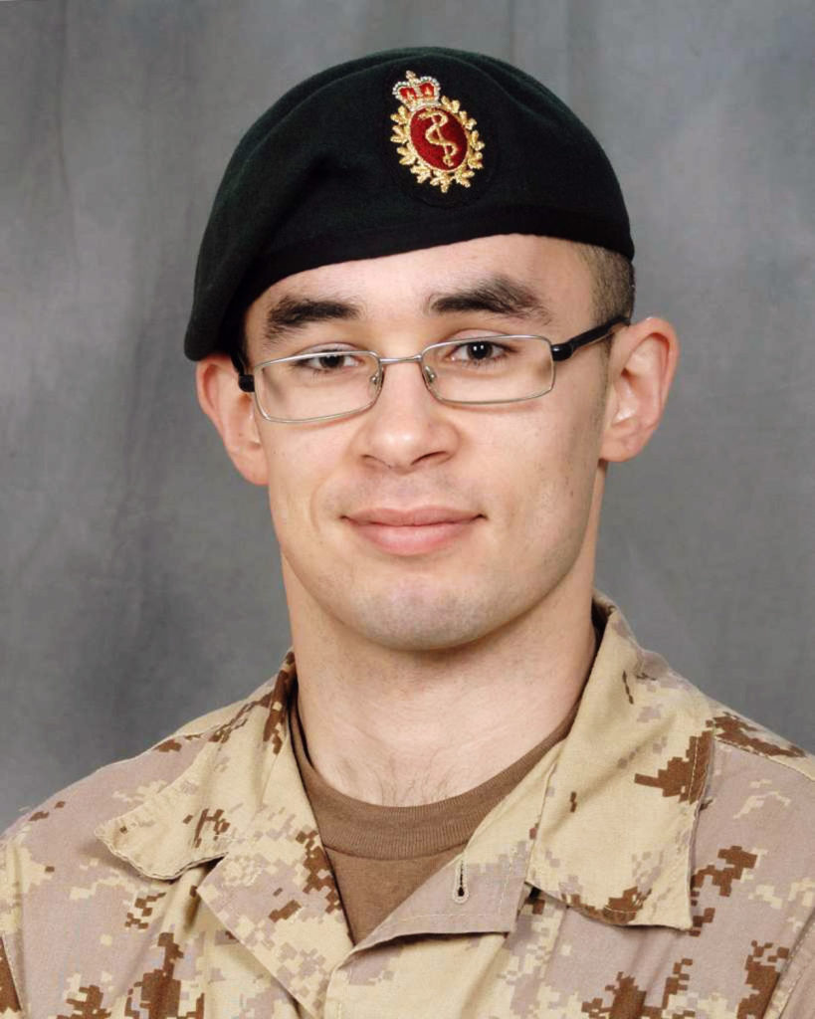
HERO WOD #20: Wilmot
Saturday 0430
Background: Dedicated to Canadian Forces Private Colin Wilmot, 24, of Fredericton, NB, assigned to the Second Battalion, Princess Patricia’s Canadian Light Infantry (2 PPCLI) Battle Group, based out of Edmonton, AB, who died on July 6, 2008 from wounds suffered when an explosive device detonated near him in the Panjwali District of Afghanistan.
He is survived by his fiancee Laura, father Eric Craig, and sister Kathleen.
6 Rounds For Time
50 Air Squats
25 Ring Dips
(Suitable scale: bench dips, floor dips, reverse table top holds)
©2026 – 24 Heroes in 24 Hours https://www.24heroes.com
Notes:
https://wodwell.com/wod/wilmot/

Slide 32
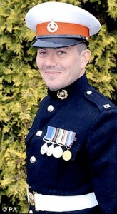
HERO WOD #2: BAZ
Friday 1030
Background:
Royal Marine Commando, Sergeant Barry Weston, 40, of Reading, England, serving with 42 Commando, Royal Marines was killed on August the 30th 2011, by a roadside bomb while leading a patrol near the village of Sukmanda in Afghanistan. Barry Weston is survived by his wife Joanne and their three daughters, Jasmine, Poppy and Rose.
“Baz” was said to have two great passions in life, the Royal Marines and his family. A loving husband and devoted father. He was a man that represented the highest standards and led his men in an exemplary fashion.
AMRAP in 30 minutes
30 Double-Unders
8 Squat Cleans (155/110 lb)
11 Hand Release Push-Ups
©2026 – 24 Heroes in 24 Hours https://www.24heroes.com

Slide 33
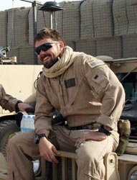
HERO WOD #7: Roy
Friday 1630
Background: Marine Corps Sgt. Michael C. Roy, 25, of North Fort Myers, FL, assigned to the 3rd Marine Special Operations Battalion, Marine Special Operations Advisor Group, Marine Corps Forces Special Operations Command at Camp Lejeune, was killed in action on July 8, 2009 in Nimroz Province, Afghanistan, while supporting combat operations.
He is survived by his wife Amy and three children, Michael, Landon, and Olivia.
5 Rounds For Time
15 Deadlifts (225/155 lb)
20 Box Jumps (24/20 in)
25 Pull-Ups
©2026 – 24 Heroes in 24 Hours https://www.24heroes.com

Slide 34
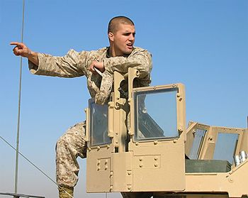
HERO WOD #3: Manion
Friday 1130
Background: Dedicated to First Lieutenant Travis Manion, 26, of Doylestown, PA, assigned to 1st Reconnaissance Battalion, 1st Marine Division, I Marine Expeditionary Force, based in Camp Pendleton, CA, killed by sniper fire on April 29, 2007, while fighting against an enemy ambush in Anbar Province, Iraq. He is survived by his father, Colonel Tom Manion, mother Janet Manion, and sister Ryan Borek.
According to Manion’s sister, Ryan, the workout is comprised of some of her brother’s favorite exercises. “This WOD was very deliberate in the way it was put together.” She serves as president of the Travis Manion Foundation @travismanionfoundation, which provides resources for veterans and hosts community service projects. “My brother was a wrestler at the Naval Academy and had very strong legs, so this WOD is all dedicated to legs,” she says.
7 Rounds For Time
400 meter Run
29 Back Squats (135/95 lb)
©2026 – 24 Heroes in 24 Hours https://www.24heroes.com

Slide 35
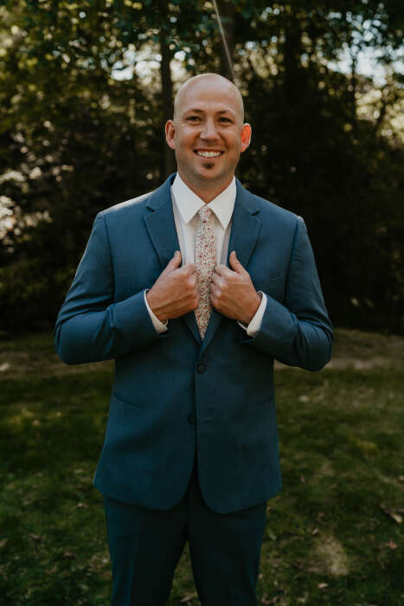
HERO WOD #5: Philip M. Wigal
Friday 1330
Background: This workout is dedicated to Lt. Philip M. Wigal , 35, who tragically lost his life on April 11, 2022, while conducting a report on a crash along Interstate 71, near state Route 301, in West Salem, Ohio.
Lt. Wigal began his career with the fire department in August of 2006 as a part-time firefighter. He was promoted to Lieutenant in 2011 and he was hired as a full-time employee in May 2014. Hefleft behind his spouse, Lindsey, and two daughters.
The rep scheme signifies:
– 1506 meter for Philip’s unit number
– 157 calorie for Philip’s engine number
– 35 Devil Presses for Philip’s age when he died
– 4 Bear Complexes for the month of the incident
– 11 Synchronized Bar Over Burpees for the day.
For Time (with a Partner)
1,506 meter Row
157 calorie Bike
35 Devil Presses (2x50/35 lb)
4 Bear Complexes (95/65 lb)*
11 Synchronized Bar Over Burpees
As a reminder, 1 Bear Complex is
7 Unbroken Reps of:
1 Clean
1 Front Squat
1 Push Press
1 Back Squat
1 Push Press
©2026 – 24 Heroes in 24 Hours https://www.24heroes.com

Slide 36
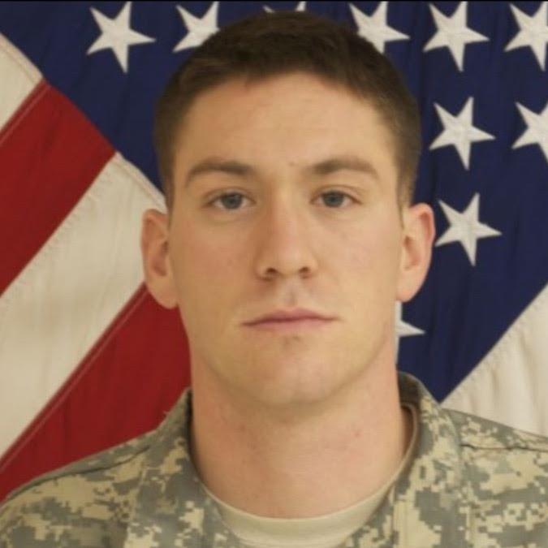
HERO WOD #6: Ollis
Friday 1430
Background: This workout is dedicated to Staff Sergeant Michael Ollis who died on August 28, 2013, while saving the life of a fellow soldier during an attack on Forward Operating Base Ghazni in Afghanistan involving grenades, mortars, rockets, and a 3,000-pound bomb.
SSG Ollis was a Non-Commissioned Officer in B Company 2-22 IN. He lost his life after heroically shielding Polish Army Lieutenant Karol Cierpica from a suicide bomber, which took place after the two soldiers stood side-by-side and defended the base armed with only their rifles. SSG Ollis incapacitated the insurgent, but the vest detonated and mortally wounded him.
AMRAP in 22 minutes of:
200 meter Run
22 Deadlifts (185/125 lb)
22 Pull-Ups
22 Burpees
22 Russian KB Swings (53/35 lb)
22 Walking Lunges (L+R=1)
©2026 – 24 Heroes in 24 Hours https://www.24heroes.com
Notes:
According to a write-up from Morning Chalk Up, SSG Ollis posthumously received the Silver Star, which was upgraded in 2019 to the Distinguished Service Cross, the second highest military honor that can be awarded to a member of the United States Army. SSG Ollis also posthumously received the Polish Armed Forces Gold Medal.
The workout was designed by SFC Joshua Coronado and CPT Brian Quinn. They wanted the number two to represent the 22nd Infantry Regiment in which SSG. Ollis served.
Additionally, they wanted to focus on effort level among the participants instead of skill or experience in higher technical movements.
“This string of movements is going to keep an individual at a high heart rate throughout the workout. It can only scratch the surface of what it feels like to be in a combat situation like Michael found himself in. Adrenaline rushing, pushing through the fear, making hard choices, and pushing yourself beyond the normal threshold. Michael Ollis was in great shape during his time in service, always leading from the front. A 22-minute AMRAP was chosen so that individuals would have a number of rounds or repetitions to which they can strive to beat each time they do this, moving further, faster, and fighting harder each time in memoriam of Michael’s efforts that day.” – SFC Coronado explained.

Slide 37
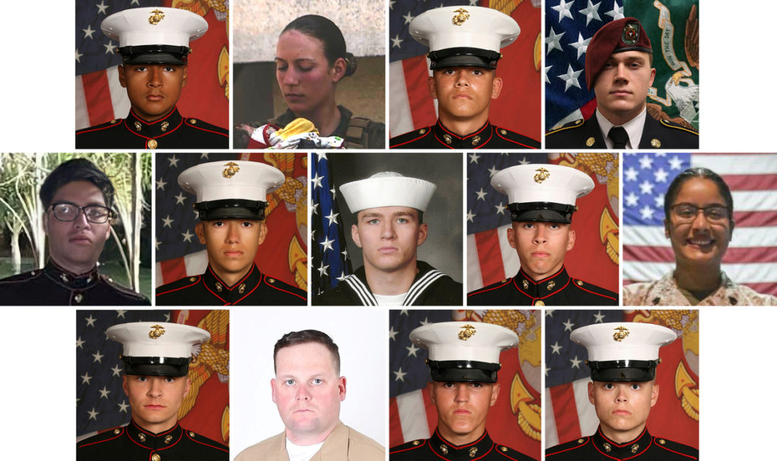
HERO WOD #7: The Thirteen
Friday 1430
Background: This workout is dedicated to the 13 service members – 11 Marines, an Army Corpsman, and a Navy Corpsman – who died on August 26, 2021, at the airport in Kabul, Afghanistan, while engaged in a dangerous, selfless mission to save the lives of others. They were assisting in the evacuation of US Citizens and friendly Afghan nationals.
The attack marked one of the deadliest days for American forces in the past decade of the 20-year war in Afghanistan — and took place just days ahead of the U.S.’s planned full withdrawal from the country that was overtaken on Aug. 15 by the Taliban.
For Time
20 Deadlifts (75/55 lb)
23 Hang Power Cleans (75/55 lb)
31 Front Squats (75/55 lb)
23 Push Presses (75/55 lb)
22 Box Jump Overs (24/20 in)
20 Butterfly Sit-Ups
20 Reverse Step Lunges
Perform 13 Burpees after each movement.
20 Pull-Ups
23 Goblet Squats (53/35 lb)
25 American Kettlebell Swings (53/35 lb)
22 Power Snatches (75/55 lb)
20 Overhead Squats (75/55 lb)
22 Thrusters (75/55 lb)
The soldiers who sacrificed their lives were:
– Dylan Merola – 20
– Daegan William-Tyeler Page – 23
– Humberto Sanchez – 22
– Johanny Rosario – 25
– Nicole Gee – 23
– Hunter Lopez – 22
– Taylor Hoover – 31
– Ryan Knauss – 23
– David Lee Espinoza – 20
– Rylee McCollum – 20
– Jared Schmitz – 20
– Kareem Nikoui – 20
– Max Soviak – 22
©2026 – 24 Heroes in 24 Hours https://www.24heroes.com

Slide 38
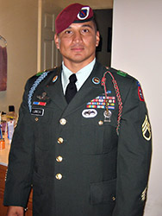
HERO WOD #8: Loredo
Friday 1630
Background: U.S. Army Staff Sergeant Edwardo Loredo, 34, of Houston, TX, assigned to the 2nd Battalion, 508th Parachute Infantry Regiment, 4th Brigade Combat Team, 82d Airborne Division, based in Fort Bragg, NC, was killed on June 24, 2010 in Jelewar, Afghanistan, when insurgents attacked his unit with an improvised explosive device.
He is survived by his wife, First Sergeant Jennifer Loredo; his daughter, Laura Isabelle; his stepdaughter, Alexis; and his son, Eduardo Enrique.
The 6 rounds represent the month (June) and 24 repetitions represent the day Eddie died.
6 Rounds For Time
24 Air Squats
24 Push-Ups
24 Walking Lunges
400 meter Run
©2026 – 24 Heroes in 24 Hours https://www.24heroes.com
Notes:
https://www.wral.com/fort-bragg-child-development-center-opens-in-honor-of-fallen-soldier-/15923724/

Slide 39
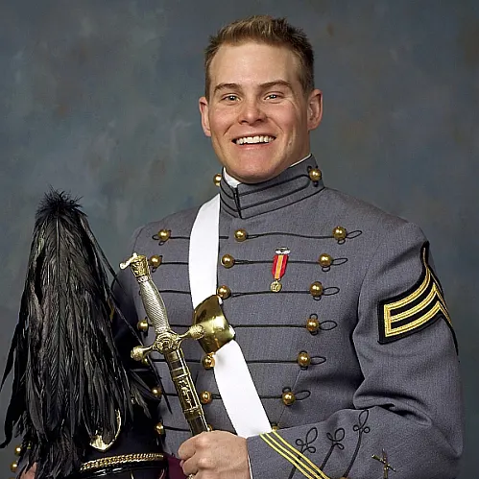
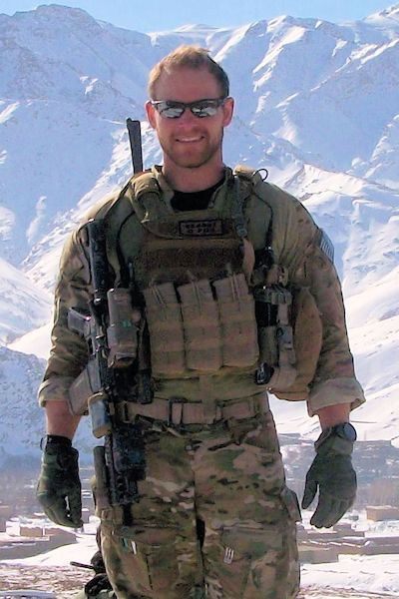
HERO WOD #16: PK
Saturday 0030
BackgroundU.S. Army Capt. Andrew Pedersen-Keel, of South Miami, Florida, died March 11, 2013. The 28-year-old was assigned to 1st Battalion, 3rd Special Forces Group (Airborne), in Fort Bragg, North Carolina. Pedersen-Keel was fatally injured in Jalrez District, Afghanistan, from small-arms fire from an Afghan security-forces member. He is survived by his mother and stepfather, Helen Pedersen Keiser and Bob Keiser; father, Henry Keel; sister, Mary Elizabeth Keel; and fiancèe, Celeste Pizza.
Bob and Helen Pedersen-Keiser, parents of Capt. Andrew Pedersen-Keel, created APK Charities “to properly honor and remember the ultimate sacrifice made by Captain Andrew M. Pedersen-Keel, US Army Special Forces.” The APK Charities provides financial aid and material assistance to charitable organizations and causes.
5 Rounds for Time
10 Back Squats (225/155 lb)
10 Deadlifts (275/185 lb)
400 meter Sprint
2 minutes Rest
©2026 – 24 Heroes in 24 Hours https://www.24heroes.com
Notes:
1st Lt. James Robert Kalsu - https://wodwell.com/wod/kalsu/

Slide 40
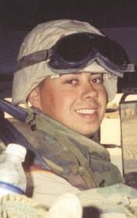
HERO WOD #19: Smette
Saturday 0330
Background: This workout is dedicated to North Dakota Army National Guard Sgt. Keith L. Smette, who died on January 24, 2004, while serving during Operation Iraqi Freedom.
Smette, 25, of Fargo, ND; assigned to the 975th Engineer Company, 130th Engineer Brigade, Army National Guard, Bismarck, ND; attached to Task Force All American; died Jan. 24 when his convoy was attacked by an improvised explosive device north of Fallujah, Iraq. ND Army National Guard Staff Sgt. Kenneth W. Hendrickson, 41, of Bismarck, ND, also died in the attack.
Smette volunteered to go to Iraq in January 2003 and withdrew from classes at NDSU to do so. He is survived by his parents, Douglas and Charlotte; his brother, Robert; his sister, Sarah; along with his grandparents and several other friends and family.
For Time (with a Partner) - 4,000/3,000 meter Row
While Partner A Rows, Partner B completes AMRAP of:
5 Toes-to-Bars
10 Wall Ball Shots (20/14 lb)
15 Push-Ups
(Switch as necessary!)
©2026 – 24 Heroes in 24 Hours https://www.24heroes.com
Notes:
https://wodwell.com/wod/smette/
For Time (with a Partner)
4,000/3,000 meter Row
While Partner A Rows, Partner B completes AMRAP of:
5 Toes-to-Bars
10 Wall Ball Shots (20/14 lb)
15 Push-Ups
Partners switch as necessary
With a running clock, complete the 4,000/3,000 meter Row as fast as possible (“For Time“). While Partner A Rows, Partner B completes as many rounds and repetitions as possible (“AMRAP“) of 5 Toes-to-Bars, 10 Wall Ball Shots, and 15 Push-Ups. Switch as necessary and pick up where the other partner left off.
If one partner is male and the other is female, use 3,500 meters for the Row distance.
Score is the time on the clock when the Row is completed and the total number of rounds and repetitions completed of the AMRAP portion of the workout.

Slide 41
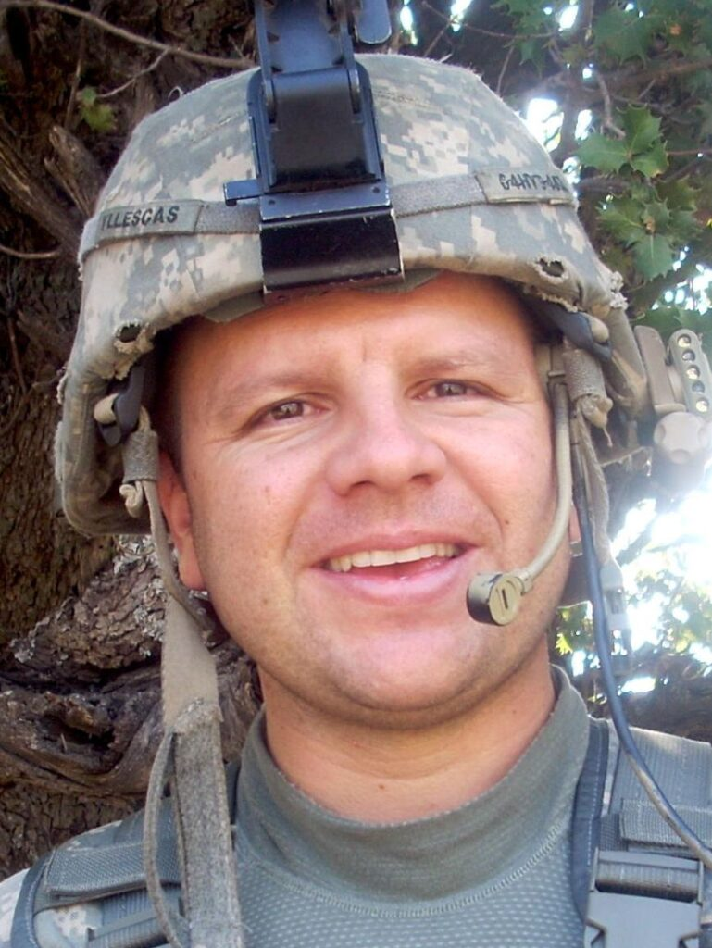
HERO WOD #11: Yllescas
Friday 1930
Background: This workout is dedicated to Captain Robert J. Yllescas, 31, who died on December 1, 2008 from wounds he suffered on October 28th when a makeshift bomb detonated near his unit in Afghanistan. He was assigned to the 6th Squadron, 4th Cavalry Regiment, 3rd Brigade Combat Team 1st Infantry Division out of Fort Hood, Texas.
Rob loved Husker football, his family, and outdoor activities. He was a highly respected leader for his soldiers, and many were drawn to his friendly nature. Part of his story is also depicted in the film “The Outpost” (2019). Rob left behind his wife, Dena, and two daughters Julia and Eva.
For Total Reps
Buy-In: 1 mile Run
- then, AMRAP in 15 minutes of:
12 Push-Ups
10 Wall Ball Shots (20/14 lb, 10/9 ft)
28 Sit-Ups
NOTE: Wear a Weight Vest (20/14 lb)
©2026 – 24 Heroes in 24 Hours https://www.24heroes.com
Notes:
https://wodwell.com/wod/yllescas/

